Slide 1
2 Peter 1:5-15
(English Standard Version)

Slide 2
⁵ For this very reason, make every effort to supplement your faith with virtue, and virtue with knowledge, ⁶ and knowledge with self-control, and self-control with steadfastness, and steadfastness with godliness, ⁷ and godliness with brotherly affection, and brotherly affection with love. ⁸ For if these qualities are yours and are increasing, they keep you from being ineffective or unfruitful in the knowledge of our Lord Jesus Christ. ⁹ For whoever lacks these qualities is so nearsighted that he is blind, having forgotten that he was cleansed from his former sins. ¹⁰ Therefore, brothers, be all the more diligent to confirm your calling and election, for if you practice these qualities you will never fall. ¹¹ For in this way there will be richly provided for you an entrance into the eternal kingdom of our Lord and Saviour Jesus Christ.

Slide 3
¹² Therefore I intend always to remind you of these qualities, though you know them and are established in the truth that you have. ¹³ I think it right, as long as I am in this body, to stir you up by way of reminder, ¹⁴ since I know that the putting off of my body will be soon, as our Lord Jesus Christ made clear to me. ¹⁵ And I will make every effort so that after my departure you may be able at any time to recall these things.

Slide 4
Faith and Works... Saved by faith. Saved for a life of Good Works
Christianity is much more than a system of moral guidance.
By faith, we are saved. Christ Jesus died to set us free from sin.
A twisted understanding of Christianity leads to:
Licentiousness – “I’m forgiven – I can do whatever I feel like”
EasyBelievism – “I believe, therefore I’m saved – No repentance; No good works”
The Apostles who knew Jesus best highlight how Faith and Works Must Go Together
Because Christ has given everything needed for a Godly life; bound for immortality; escaped corruption of this world that comes with sinful desire, supplement your faith with virtue
⁵ For this very reason, make every effort to supplement your faith with virtue, and virtue with knowledge, ⁶ and knowledge with self-control, and self-control with steadfastness, and steadfastness with godliness, ⁷ and godliness with brotherly affection, and brotherly affection with love.
Virtue doesn’t replace faith – it goes with; springs from; works with, faith

Slide 5
Faith and Works... Saved by faith. Saved for a life of Good Works
The Apostles who knew Jesus best highlight how Faith and Works Must Go Together
Because Christ has given everything needed for a Godly life; bound for immortality; escaped corruption of this world that comes with sinful desire, supplement your faith with virtue
Make every effort to supplement your faith with these virtues:
virtue
Excellence of character. No excuses. No cop-out. MAKE EVERY EFFORT.
knowledge
Wisdom & discernment needed to live a Godly life.
Learn from Apostles teaching. When close to God, we love to study the Scriptures.
self-control
to control our sinful, sensual desires
steadfastness
no ‘fair-weather Christians. If I fall away from following Jesus, there is no benefit
^{Matthew 10:22 (ESV) 22} and you will be hated by all for my name’s sake. But the one who endures to the end will be saved.

Slide 6
Faith and Works... Saved by faith. Saved for a life of Good Works
The Apostles who knew Jesus best highlight how Faith and Works Must Go Together
Because Christ has given everything needed for a Godly life; bound for immortality; escaped corruption of this world that comes with sinful desire, supplement your faith with virtue
Make every effort to supplement your faith with these virtues:
virtue
Excellence of character. No excuses. No cop-out. MAKE EVERY EFFORT.
knowledge
Wisdom & discernment needed to live a Godly life.
Learn from Apostles teaching. When close to God, we love to study the Scriptures.
self-control
to control our sinful, sensual desires
steadfastness
no ‘fair-weather Christians. If I fall away from following Jesus, there is no benefit
godliness
devoutness; piety; religious reverence; fear of God
brotherly affection
Love
^{John 13:35 (ESV) 35} By this all people will know that you are my disciples, if you have love for one another.”
Loving the family of God

Slide 7
Faith and Works... Saved by faith. Saved for a life of Good Works
Make every effort to supplement your faith with these virtues:
virtue
Excellence of character. No excuses. No cop-out. MAKE EVERY EFFORT.
knowledge
Wisdom & discernment needed to live a Godly life.
Learn from Apostles teaching. When close to God, we love to study the Scriptures.
self-control
to control our sinful, sensual desires
steadfastness
no ‘fair-weather Christians. If I fall away from following Jesus, there is no benefit
godliness
devoutness; piety; religious reverence; fear of God
brotherly affection
Love
Loving the family of God
Faith isn’t meant to be left alone – Keep in step with the Spirit
⁸ For if these qualities are yours and are increasing, they keep you from being ineffective or unfruitful in the knowledge of our Lord Jesus Christ.
⁹ For whoever lacks these qualities is so nearsighted that he is blind, having forgotten that he was cleansed from his former sins.
Remember how we are forgiven from Sin and we will strive to live in all Godliness, virtue & love

Slide 8
Faith and Works... Saved by faith. Saved for a life of Good Works
Make every effort to supplement your faith with these virtues:
virtue
Excellence of character. No excuses. No cop-out. MAKE EVERY EFFORT.
knowledge
Wisdom & discernment needed to live a Godly life.
Learn from Apostles teaching. When close to God, we love to study the Scriptures.
self-control
to control our sinful, sensual desires
steadfastness
no ‘fair-weather Christians. If I fall away from following Jesus, there is no benefit
godliness
devoutness; piety; religious reverence; fear of God
brotherly affection
Love
Loving the family of God
Faith isn’t meant to be left alone – Keep in step with the Spirit
Remember how we are forgiven from Sin and we will strive to live in all Godliness, virtue & love
In God’s sovereign grace, He calls us and chooses us to be saved. But we also have a part to play
To fall is to stumble on the road to salvation and ‘come to grief’
¹⁰ Therefore, brothers, be all the more diligent to confirm your calling and election, for if you practice these qualities you will never fall. ¹¹ For in this way there will be richly provided for you an entrance into the eternal kingdom of our Lord and Saviour Jesus Christ.

Slide 9
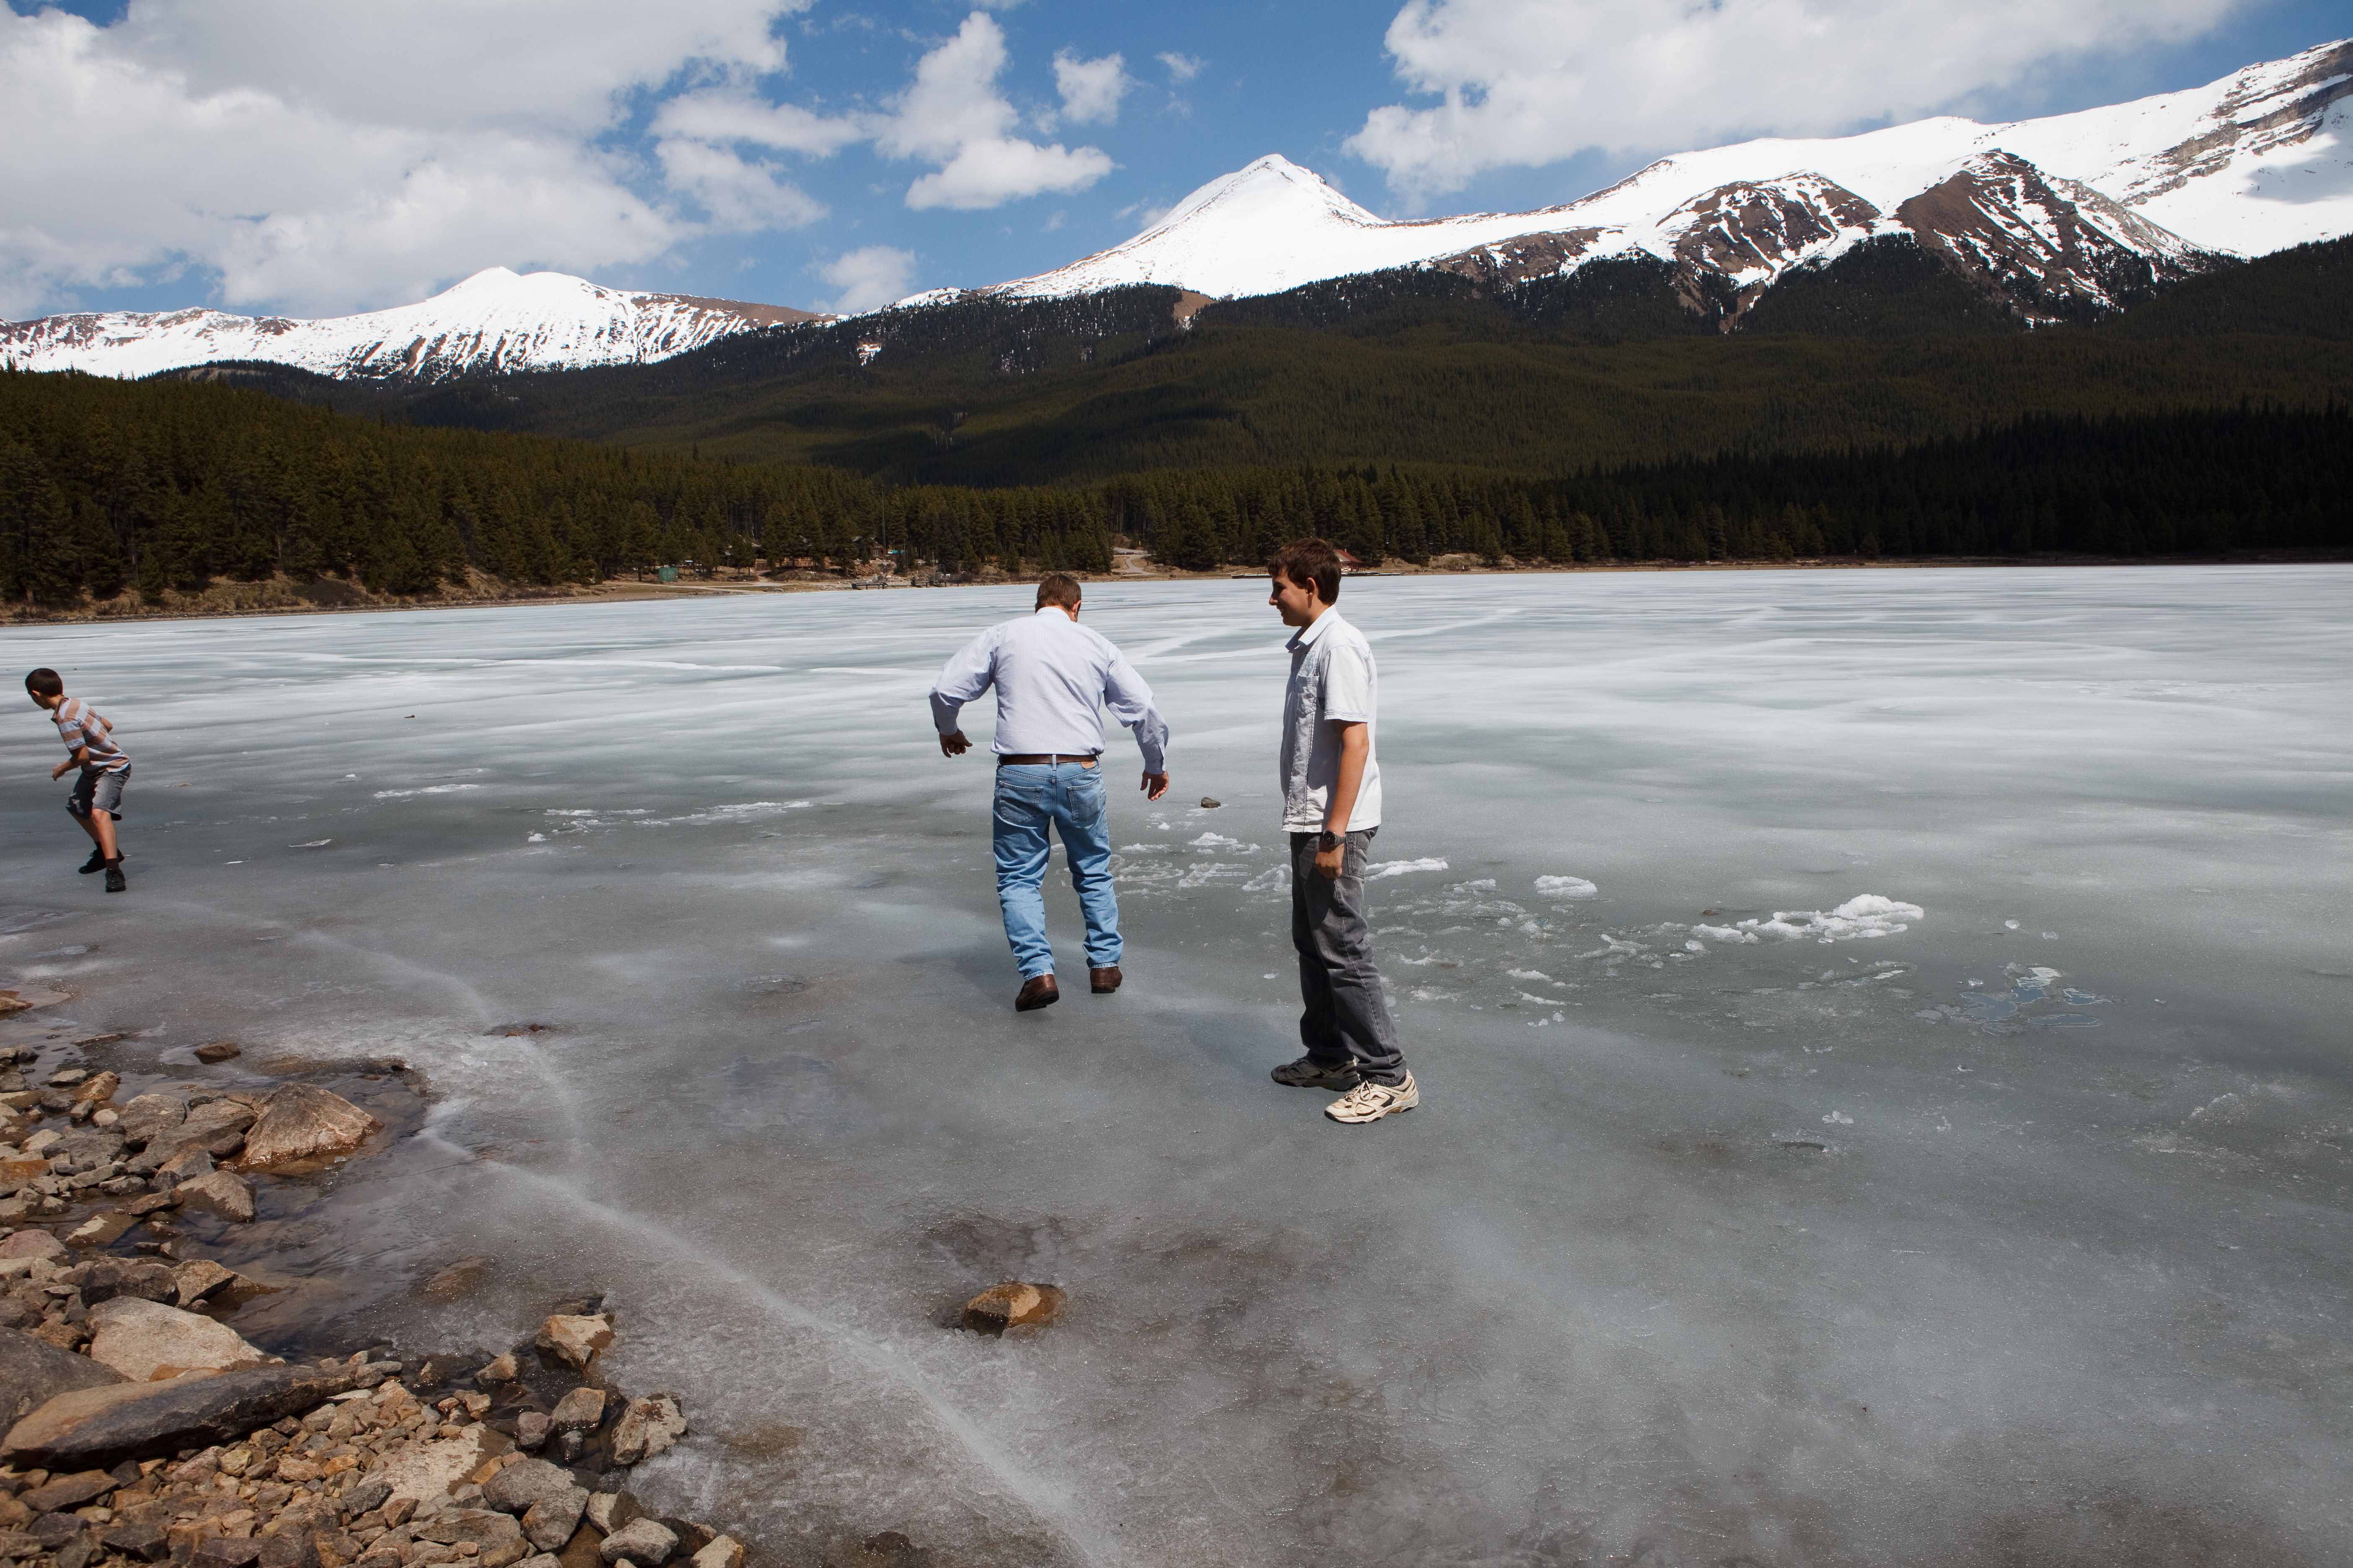

Slide 10
Faith and Works... Saved by faith. Saved for a life of Good Works
Make every effort to supplement your faith with these virtues:
virtue
Excellence of character. No excuses. No cop-out. MAKE EVERY EFFORT.
knowledge
Wisdom & discernment needed to live a Godly life.
Learn from Apostles teaching. When close to God, we love to study the Scriptures.
self-control
to control our sinful, sensual desires
steadfastness
no ‘fair-weather Christians. If I fall away from following Jesus, there is no benefit
godliness
devoutness; piety; religious reverence; fear of God
brotherly affection
Love
Loving the family of God
Faith isn’t meant to be left alone – Keep in step with the Spirit
Remember how we are forgiven from Sin and we will strive to live in all Godliness, virtue & love
In God’s sovereign grace, He calls us and chooses us to be saved. But we also have a part to play
To fall is to stumble on the road to salvation and ‘come to grief’
If I have been set free from sin, I will want to walk in the ways of Jesus
¹⁰ Therefore, brothers, be all the more diligent to confirm your calling and election, for if you practice these qualities you will never fall. ¹¹ For in this way there will be richly provided for you an entrance into the eternal kingdom of our Lord and Saviour Jesus Christ.

